Slide 1



X
Kimia Farma Business Performance Analytics Business Year 2020-2023
Kimia Farma - Big Data Analytics
Presented by
Haris Dwi Rahmatullah

Slide 2






X
Haris Dwi Rahmatullah, S.Pi
AWS re/Start Graduate | Data Analytics | DB Admin | Cloud Computing
I got my bachelor degree on Aquaculture from Univeritas Airlangga in Sept 2019. As a Non IT guy who wants to break a career on tech industry, I considering myself as a polyglot. Aside from Javanese and English, I can speak Python, SQL, and little bit of JS and Bash
Gresik, East Java
harisdwir@gmail.com
Haris Dwi Rahmatullah

Slide 3
X
Courses and Certification
Programming in Python | https://coursera.org/verify/C2BSU65G8HU7 Apr, 2024 Advanced MySQL | https://coursera.org/verify/779K4R38MGPV Apr, 2024
AWS CCP | https://aws.amazon.com/verification (credential: LSL3C3GDSNQQ193B) Dec, 2023

Slide 4

X
About Company
Kimia Farma adalah perusahaan industri farmasi pertama di Indonesia yang didirikan oleh Pemerintah Hindia Belanda tahun 1817. Nama perusahaan ini pada awalnya adalah NV Chemicalien Handle Rathkamp & Co. Berdasarkan kebijaksanaan nasionalisasi atas eks perusahaan Belanda di masa awal kemerdekaan.
Pada tanggal 4 Juli 2001, PT Kimia Farma (Persero) kembali mengubah statusnya menjadi perusahaan publik, PT Kimia Farma (Persero) Tbk, dalam penulisan berikutnya disebut Perseroan. Bersamaan dengan perubahan tersebut, Perseroan telah dicatatkan pada Bursa Efek Jakarta dan Bursa Efek Surabaya (sekarang kedua bursa telah merger dan kini bernama Bursa Efek Indonesia). Berbekal pengalaman selama puluhan tahun, Perseroan telah berkembang menjadi perusahaan dengan pelayanan kesehatan terintegrasi di Indonesia. Perseroan kian diperhitungkan kiprahnya dalam pengembangan dan pembangunan bangsa, khususnya pembangunan kesehatan masyarakat Indonesia.

Slide 5
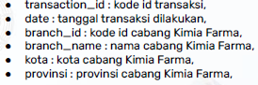
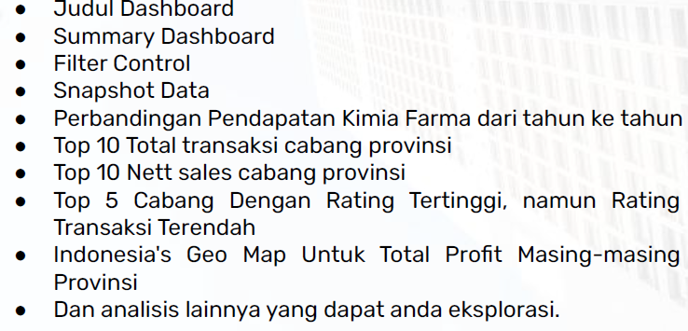


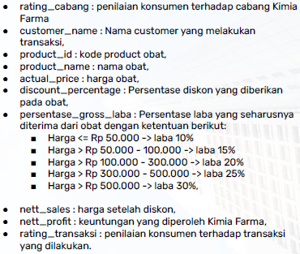


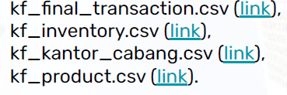
X
Project Portfolio
As a Big Data Analytics Intern on Kimia Farma, one of the largest pharmaceutical company on Indonesia, I want to show my data analytics skill to evaluate business performance of Kimia Farma from 2020 to 2023. It start with uploading raw data to data warehousing service such as Google BigQuery. Write SQL syntax to perform data querying. Then, connect the data to Looker Studio to make a analytical dashboard.
Analysis Table
Dashboard
Tools
Raw Data
Project explanation video here!

Slide 6
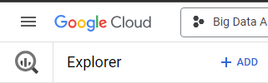
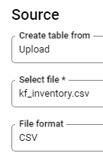
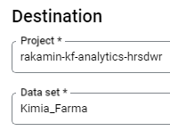
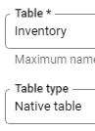
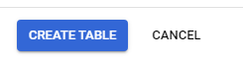
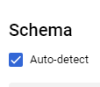
X
Importing Dataset to BigQuery
Pilih file yang akan diimport
Pastikan filenya berekstensi .csv
Buat proyek dan dataset baru sesuai nama disamping
Klik tombol Add pada konsol Google Cloud, kemudian klik Local file untuk mengupload dataset
Tuliskan nama tabel dan biarkan lainnya as a default
Klik CREATE TABLE untuk memfinalisasi
Jangan lupa untuk mencentang opsi Auto-detect

Slide 7
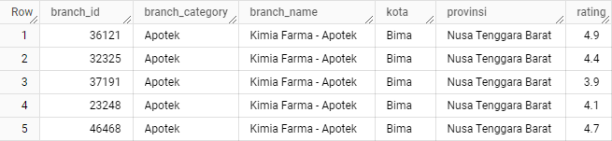
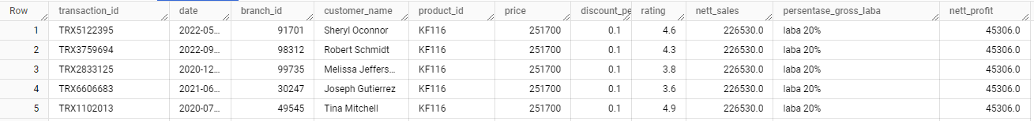
X
Tabel Analisa
Tabel Kantor Cabang
Tabel Final Transaction

Slide 8
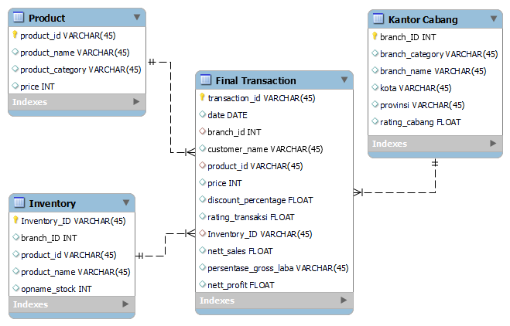
Entity Relationship Diagram
X
I created this diagram with MySQL Workbench so I know the relationship between each table
I also applied star scheme where a central dimension table (Final Transaction) surrounded by three fact table.
Next, I assign Primary Key and Foreign Key and check the atomicity on each table to perform First Database Normal Form (1NF).
Inventory_ID column was added to Final Transaction and Inventory Table to give atomicity and reduce dependencies to perform Second Database Normal Form (2NF)

Slide 9
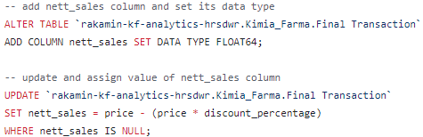
X
BigQuery Syntax
Nett Sales Column
Add nett_sales column by performing CREATE operation and use ALTER TABLE and ADD COLUMN command
Add the dataset and table where you want to add the column. Don’t forget to give a single quote (‘) symbol
Use ADD COLUMN to add new column and use FLOAT64 data type
Perform UPDATE operation use UPDATE command, and use SET to assign the value on certain column and use WHERE clause to filter column. Here I use IS NULL as a filter column. Because I want to assign value to the empty nett_sales column.
Don’t forget to give a semicolon (;) symbol on each code block.
NB. BigQuery and MySQL data type are little bit different. FLOAT64 is same data type as FLOAT on MySQL

Slide 10
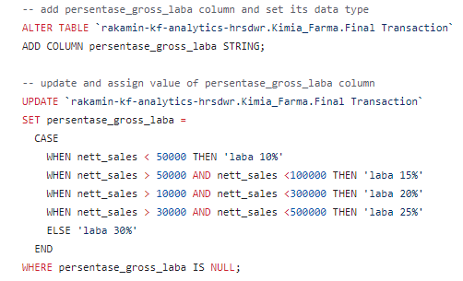
2. Persentase_gross_laba Column
X
Add the column by performing CREATE operation and use ALTER TABLE and ADD COLUMN command
Add the dataset and table where you want to add the column. Give a single quote (‘) symbol.
Use ADD COLUMN to add a column. Use STRING data type.
Perform UPDATE operation use UPDATE command, and use SET to assign the value on certain column
Use CASE statement to perform a conditional logical operation. This command like IF-ELSE on other programming language
Dont’t forget to give END command to show end of conditional statement.
Use WHERE clause to filter column. Here I use IS NULL as a filter column. Because I want to assign value to the empty column
Don’t forget to give a semicolon (;) symbol on each code block
NB. BigQuery and MySQL data type are little bit different. STRING is same data type as VARCHAR on MySQL

Slide 11
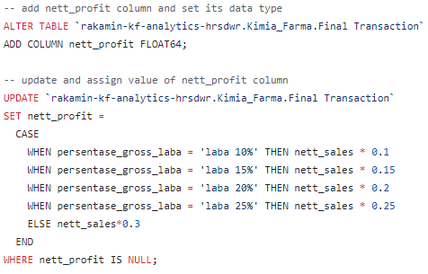
3. Nett_profit Column
X
Add the column by performing CREATE operation and use ALTER TABLE and ADD COLUMN command
Add the dataset and table where you want to add the column. Give a single quote (‘) symbol.
Use ADD COLUMN to add a column. Use FLOAT64 data type.
Perform UPDATE operation use UPDATE command, and use SET to assign the value on certain column
Use CASE statement to perform a conditional logical operation. This command like IF-ELSE on other programming language
Dont’t forget to give END command to show end of conditional statement.
Use WHERE clause to filter column. Here I use IS NULL as a filter column. Because I want to assign value to the empty column
Don’t forget to give a semicolon (;) symbol on each code block
NB. BigQuery and MySQL data type are little bit different. FLOAT64 is same data type as FLOAT on MySQL

Slide 12
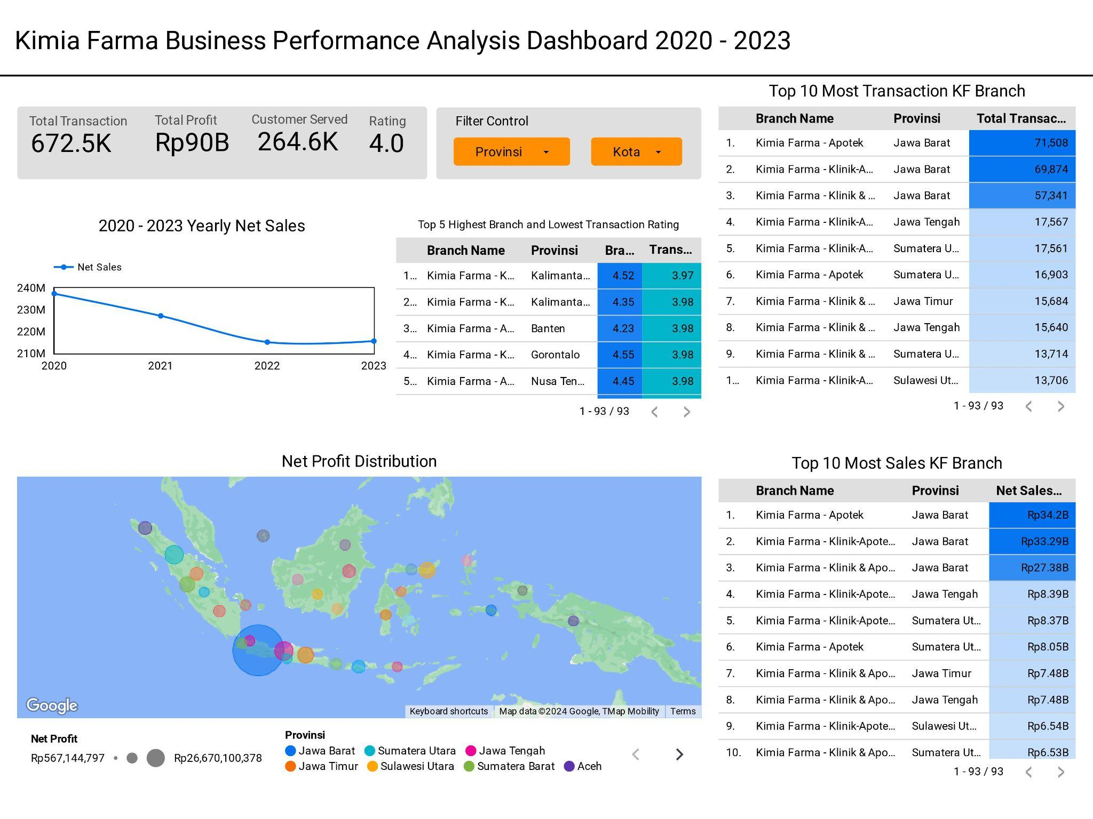
X
Dashboard Performance Analytics
Rekomendasi
Mengingat jumlah transaksi yang cukup besar, bisa melakukan up-selling dan cross-selling kepada existing customer untuk meningkatkan net profit di tahun 2024
Jumlah unique customer yang dilayani masih cukup sedikit, untuk menambah net profit bisa dengan melakukan penjualan kepada customer B2B atau dengan program referall
Looker Studio Link :
https://lookerstudio.google.com/reporting/01626241-b347-4d5f-bd87-9fd7285b447f

Slide 13
X
If you reach this slide and you have any ideas or improvement for this project, you can do a pull request on my GitHub repo. Thanks a lot
https://github.com/harisdwir/Rakamin_KF_Analytics_hrsdwr

Slide 14
Thank You
X

